Slide 1
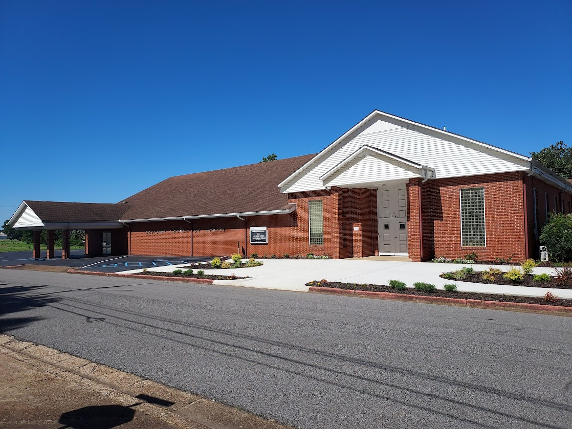

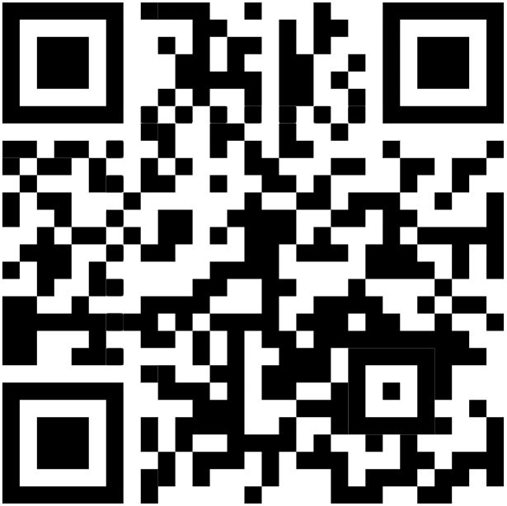
Welcome
Services will begin in:
WELCOME VISITORS
Please scan the QR code to allow us to have a record of your visit
www.eastside-church.com/welcome

Slide 2
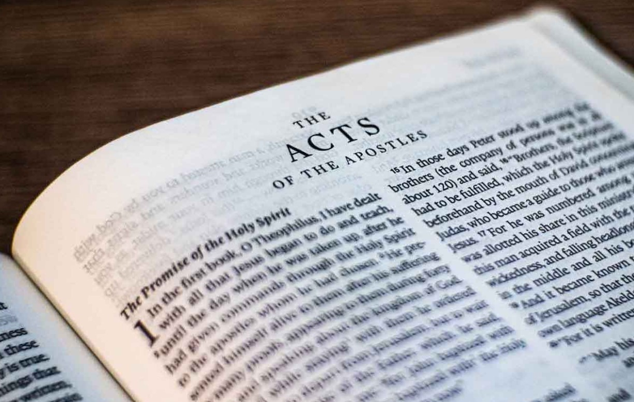
Go Tell The Good News
Acts – Part II

Slide 3
1)
2)
3)
4)
5)
6)
7)
8)
9)
10)
11)
12)
13)
14)
15)
Ascension & Appointment
Philippian Prison
16)
17)
18)
19)
20)
21)
22)
23)
24)
25)
26)
27)
28)
Pentecost & Peter’s Preaching
Addressing Athens
Lame Man & Lesson
Achaia, Antioch, & Apollos
Restrained, Released, & Request
Re-baptism, Repentance, & Riot
Deception & Detention
Macedonia & Miletus
Seven Selected
Jerusalem & Jewish Mob
Stephen Stoned
Review & Rejection
Samaria & Salvation
Council & Conspiracy
Saul Saved & Dorcas Delivered
Caesarean Confinement
Cornelius Converted
Appeal & Agrippa
Report & Relief
A
Review & Ridicule
Persecution, Peter, & Pride
Marooned On Malta
CTS
Antioch to Iconium
F
Rescued To Rome
Iconium to Antioch
ACTS
Disagreement & Decision
Alliteration Memory Statements To Help Recall Chapter Content

Slide 4
Today’s class:
Acts 28:1-31
Paul’s ministry / example in Malta
Arrival at Rome
Ministry at Rome

Slide 5
Paul’s journey to Rome
Summary
Paul had appealed to Ceasar while in Caesarea rather than be forced to return to Jerusalem to be tried by Festus and the Jewish counsel (re: Acts 25:9-12)
Paul discusses his early life and recounts his conversion before King Agrippa who is almost persuaded to become a Christian (Acts 26)
Paul’s voyage to Rome results in a shipwreck on the island of Malta (Acts 27)

Slide 6
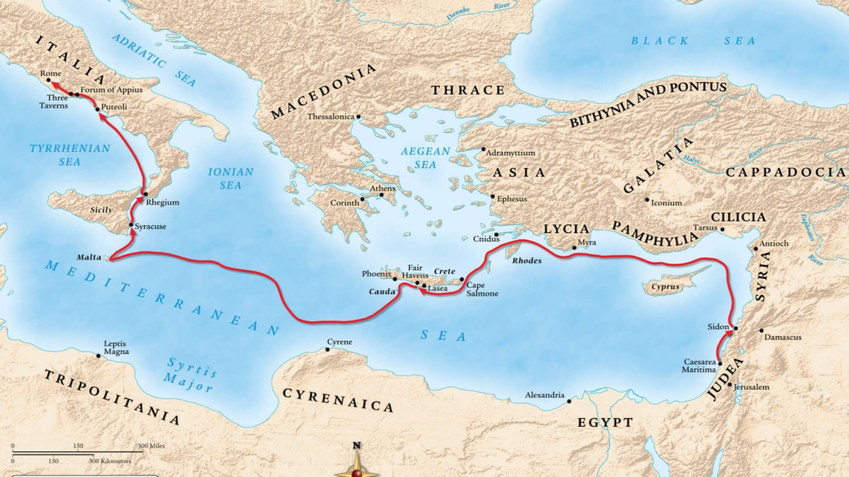
Summary

Slide 7
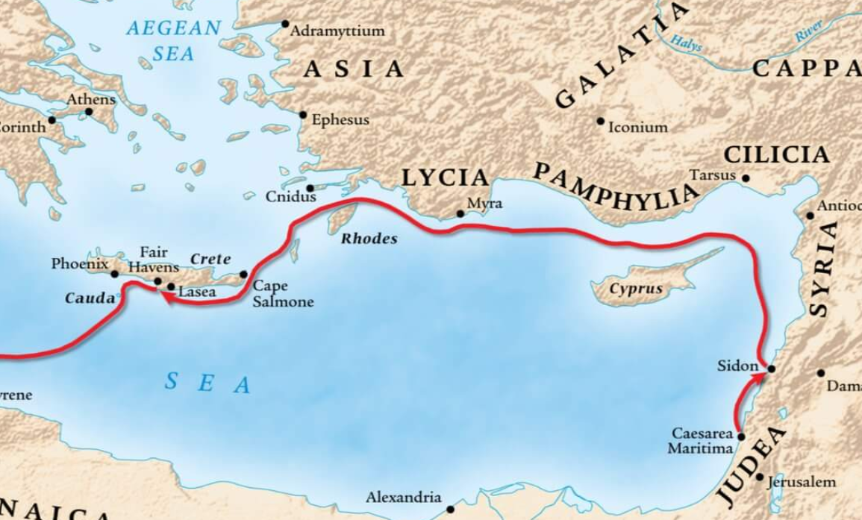
Summary

Slide 9
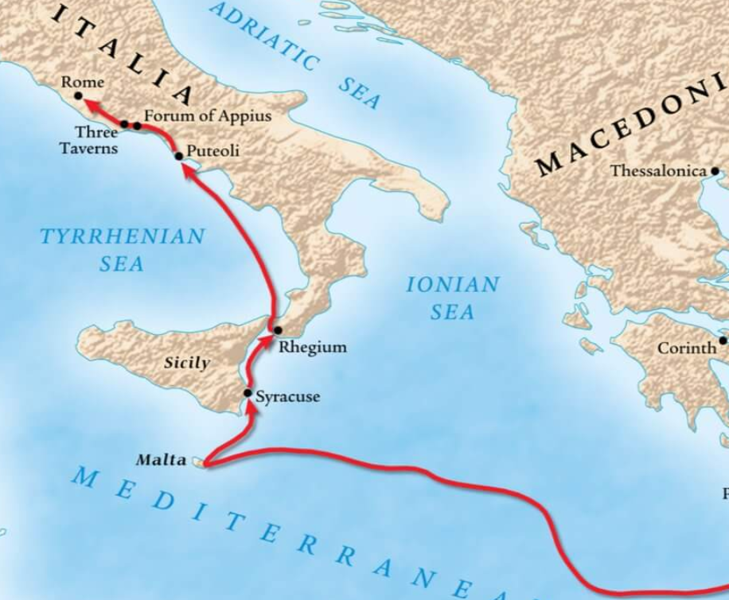
²¹ But after long abstinence from food, then Paul stood in the midst of them and said, “Men, you should have listened to me, and not have sailed from Crete and incurred this disaster and loss. ²² And now I urge you to take heart, for there will be no loss of life among you, but only of the ship. ²³ For there stood by me this night an angel of the God to whom I belong and whom I serve, ²⁴ saying, ‘Do not be afraid, Paul; you must be brought before Caesar; and indeed God has granted you all those who sail with you.’ ²⁵ Therefore take heart, men, for I believe God that it will be just as it was told me. ²⁶ However, we must run aground on a certain island.”
(Acts 27:21-26)

Slide 10
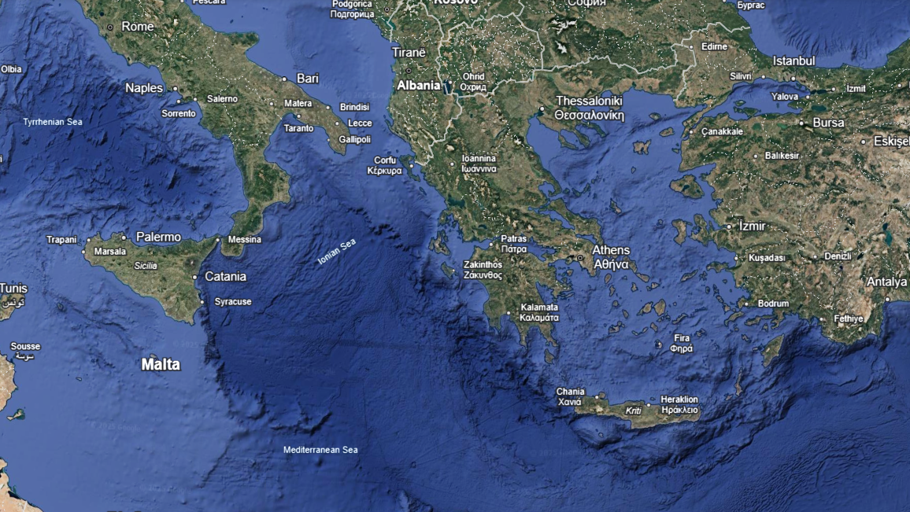

Slide 11
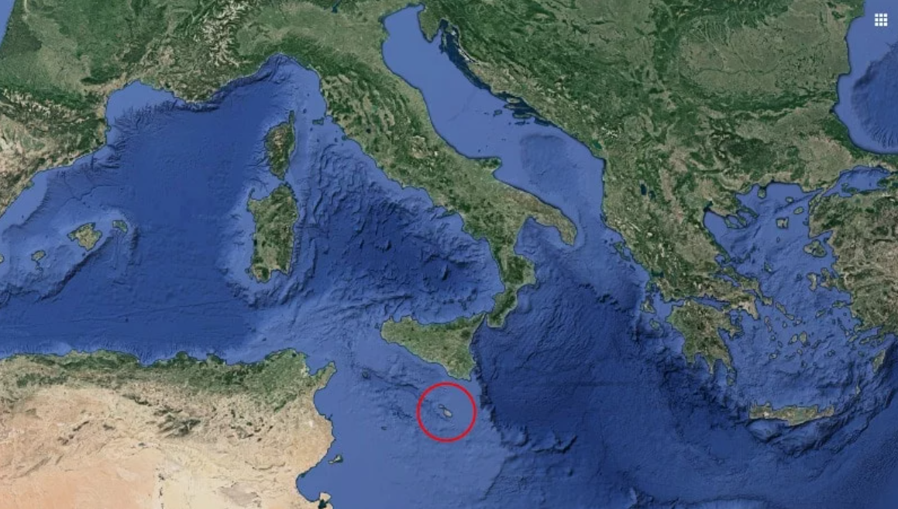

Slide 12
Acts 28:1-10
The inhabitants of Malta show unusual kindness for all the shipwrecked individuals
Paul is identified as a murderer…then a god
Paul performs miracles on the inhabitants of the island

Slide 13
Acts 28:11-16
The end of the journey to Rome

Slide 14
Acts 28:17-31
Paul speaks to the leaders of the Jews in Rome
He reminds them of the history of the Jews in rejecting the testimony of God
Paul is allowed to preach the gospel from his own house for 2 whole years

